Slide 1

Analysis on Life Expectancy using SQL and Other Analytical Tools Adewumi Eluwole

Slide 2
Project analysis slide 2
TABLE OF CONTENT
Slide 3
Slide 4-5
WHO AM I?
INTRODUCTION & OBJECTIVE
LIFE EXPECTANCY
Slide 6-7
Slide 8-9
SQL ANALYSIS
EXCEL ANALYSIS
Slide 10
Slide 11
POWER BI
PYTHON ANALYSIS

Slide 3
Project analysis slide 3
WHO AM I?
WORK EXPERIENCE
Data Analyst Volunteer (Dynastique Ltd, UK)
Customer Service Representative (Alpa Training Lab, Nigeria)
Volunteer (Statistical Department, Ewekoro Local Govt, Nigeria)
CORE SKILLS
Advanced Excel
Power BI
Tableau
R Language
Python
SQL
Agile Project Management
SAP MM
SAP SD
EDUCATION
University of Portsmouth (MSc. Digital Business Management)
Obafemi Awolowo University, Nigeria (BSc. Economics)
The Federal Polytechnic Ado-Ekiti, Nigeria (National Diploma in Mathematics & Statistics)
PERSONAL PROFILE
I am a self-motivated and result-oriented Individual with background in client management.
I am a tech-enthusiast
SOFT SKILLS
Analytical skills
Problem-Solving skills
Team-Player
Time management
Detail-Oriented
Critical thinking
Interpersonal Relationship
Administrative skills
Communication skills

Slide 4
Project analysis slide 4
INTRODUCTION
Life Expectancy is the number of years a person is expected to live based on statistical average. It measures the population health and capture the mortality along life course i.e. it tells the average age of death in a population. This project made use of Adult Mortality, Under-five death, Measles reported, Thinness(1-19years), Alcohol intake, Body Mass Index, Human Development Index, Education, Population and Expenditure on Health as proxy to measure the factors that affect Life Expectancy.

Slide 5
Project analysis slide 5
OBJECTIVES
To check how life expectancy vary over different continents.
To check and compare adult mortality and under-five deaths in the developed and the developing countries.
To analyse the effect of measles and different immunizations on life expectancy.
To check the correlation between education, expenditure on health and life expectancy.

Slide 6
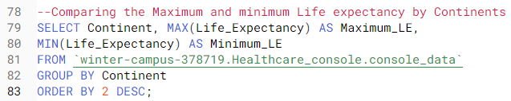
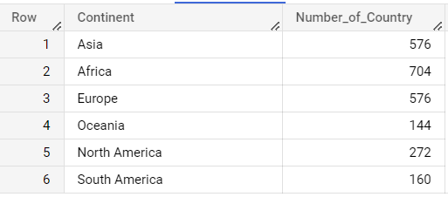
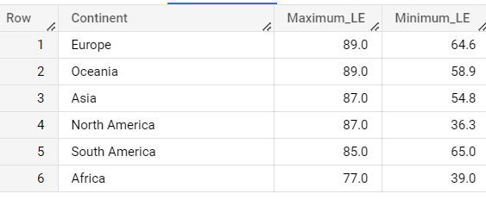
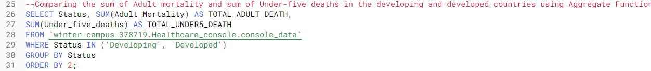
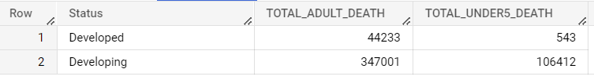
Project analysis slide 6
SQL ANALYSIS

Slide 7
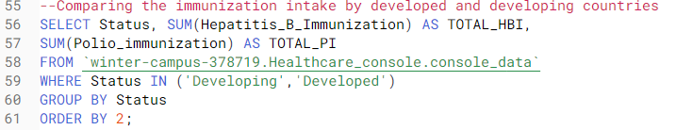
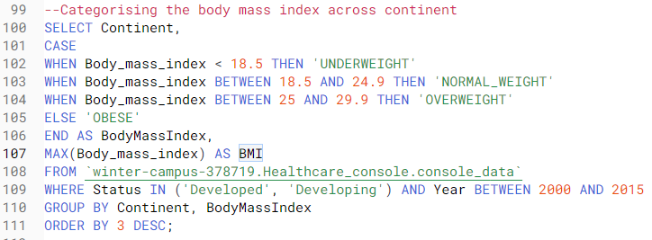

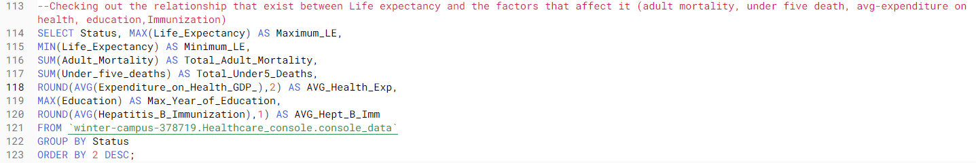
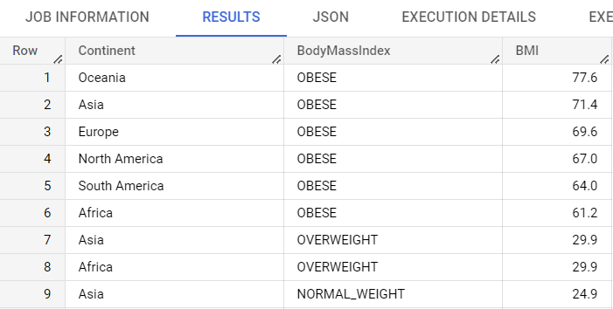
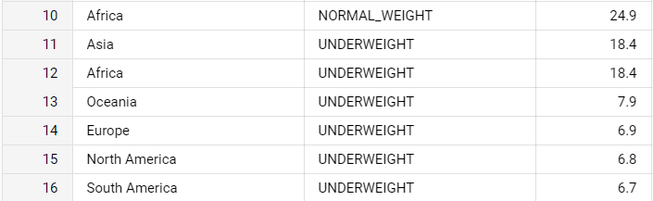
SQL ANALYSIS CONT’D

Slide 8
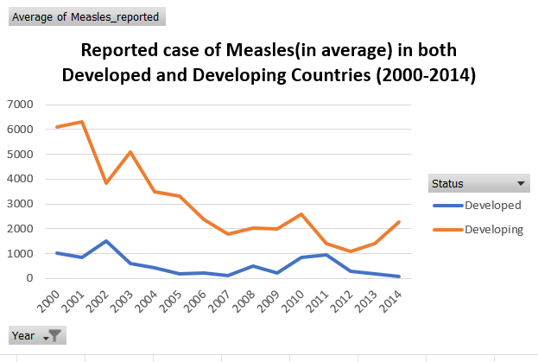
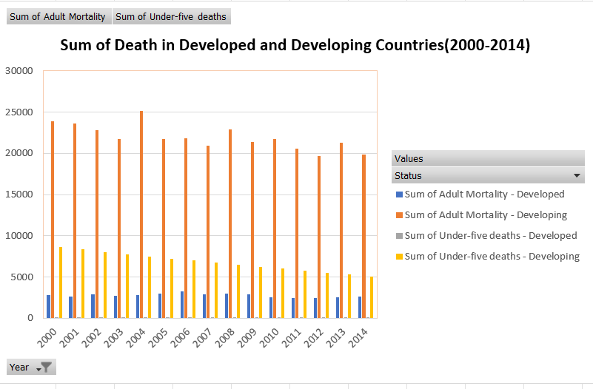
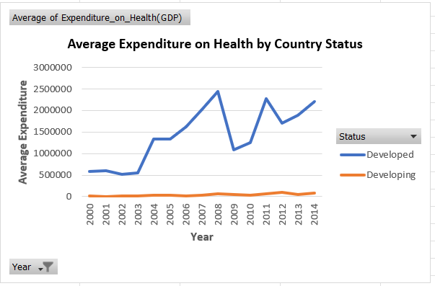
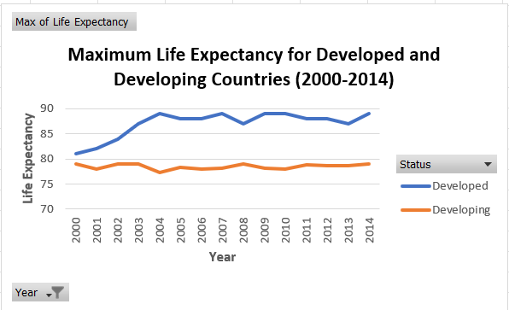
Project analysis slide 8
EXCEL ANALYSIS

Slide 9
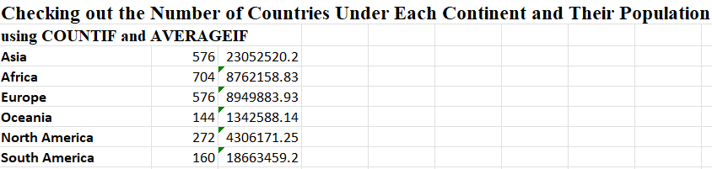
Project analysis slide 7
EXCEL ANALYSIS

Slide 10
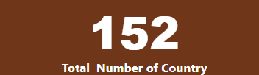
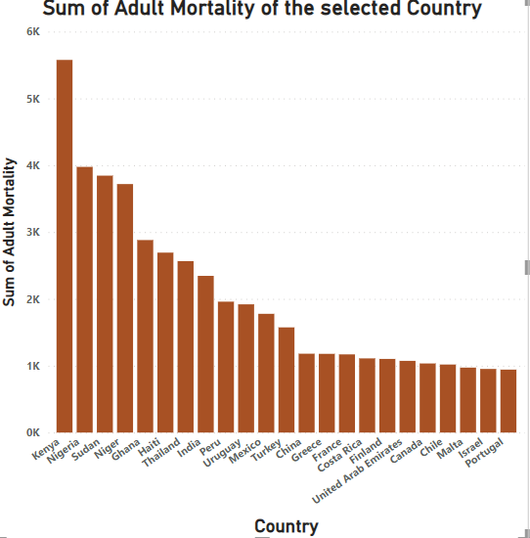
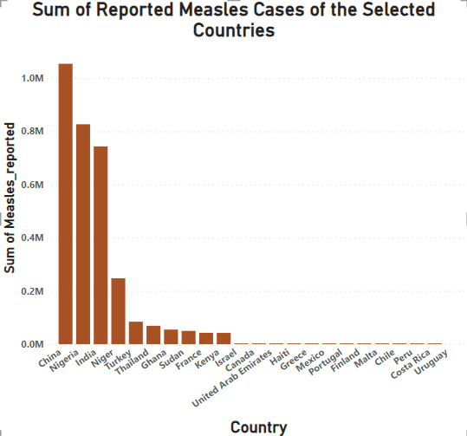
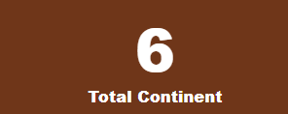
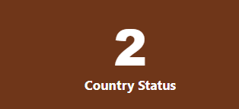
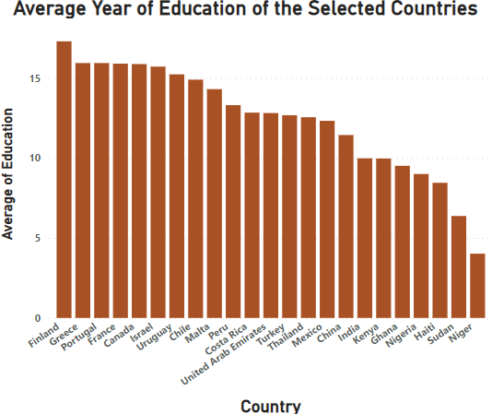
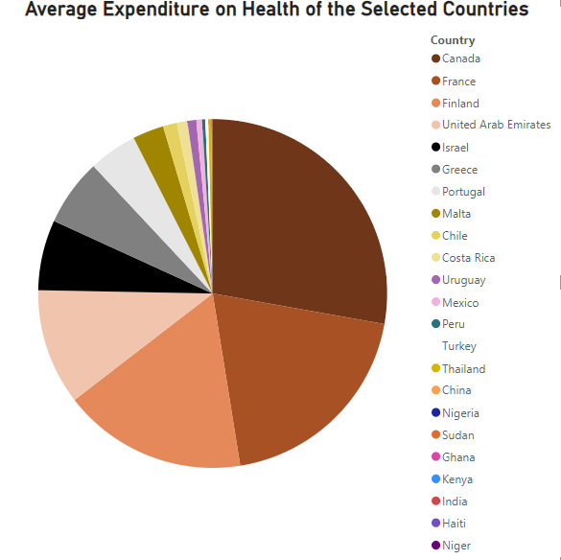
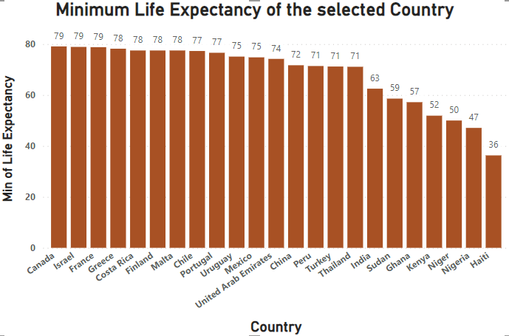
Project analysis slide 10
DASHBOARD
Using Power BI to analyse different factors affecting life expectancy by randomly selecting 5 countries from each continent.

Slide 11
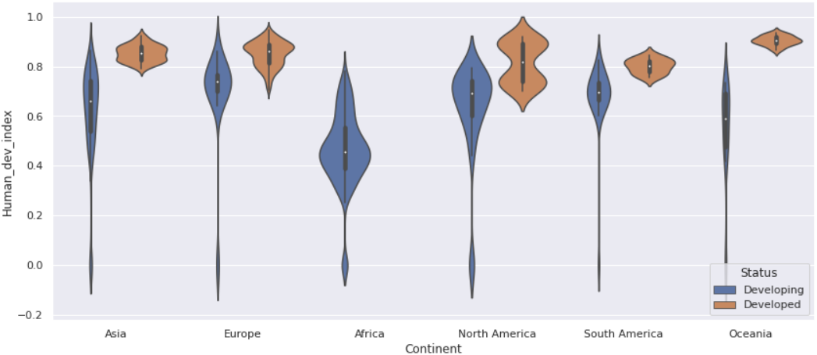
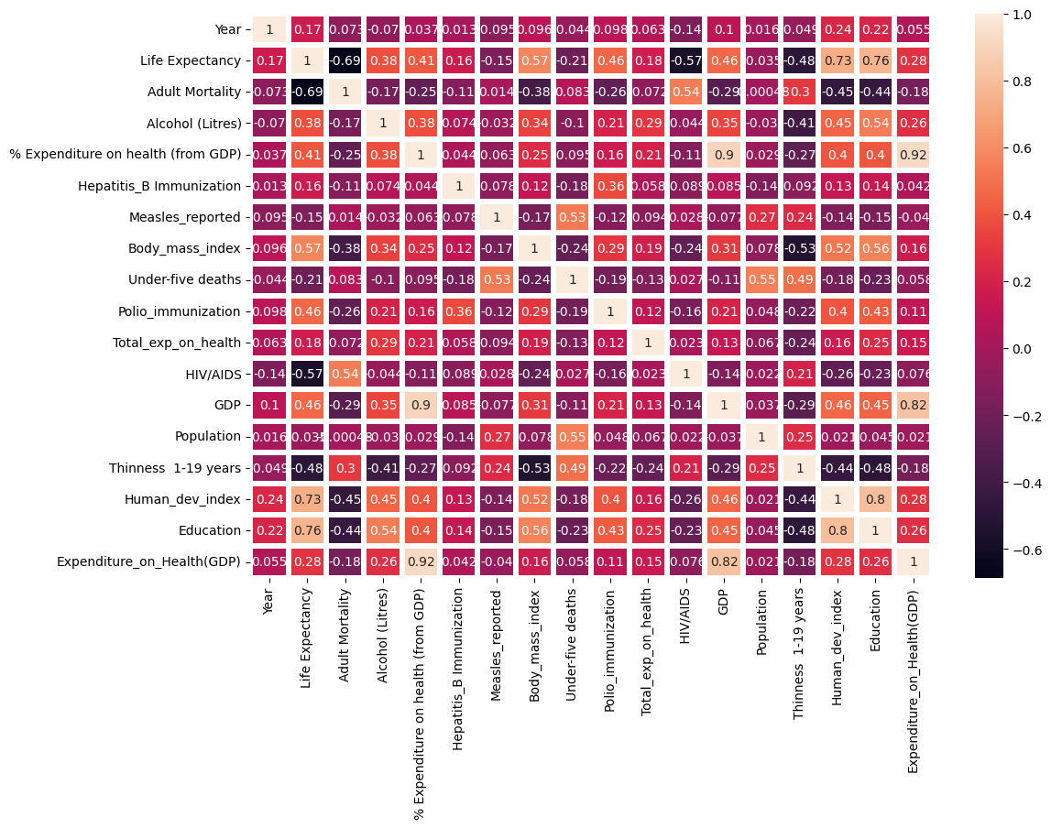
PYTHON ANALYSIS
The correlation between life expectancy and adult mortality= -0.69
The correlation between life expectancy and measles reported= -0.15
The correlation between life expectancy and polio immunization=0.46
The correlation between life expectancy and education=0.75
The correlation between life expectancy and HDI=0.73
The correlation between life expectancy and expenditure on health=0.28

Slide 12
CHALLENGES
There were lot of missing values in the dataset.
The “status” column was biased. I took it upon myself to check all the countries to correct any status that is wrong.
The continent column wasn’t part of the dataset, I created it.

Slide 13
RECOMMENDATION
The developing countries should increase their expenditure on health to increase the life expectancy.
The developing countries should create more awareness towards schooling to widen people’s knowledge on how to live healthy.
Countries in Africa and Asia should encourage policies that will reduce their population in order to make maximum use of the health resources.
Both the developed and the developing countries should educate their citizens about the importance of body mass index.

Slide 14

CONCLUSION AND KEY LEARNING
I choose Data Analytics because of my passion to tell stories with figures, my educational background in Statistics and Economics and my curiosity for technology advancement. I am prepared and ready to take the role of a Data Analyst.
Top 3 lessons I’ve learnt so far:
PERSONALLY
With determination and discipline, everything is achievable.
Marriage and motherhood is not an excuse to remain stagnant (I’m a mother of two handsome boys always aiming at distinction).
EDUCATIONAL
Learnt data manipulation using Advanced Excel and Power Query.
Data visualisation using Tableau and Power BI.
Learnt to analysis large set of data using Python and SQL.
Learnt Agile Project Management .
CAREER-WISE
Networking is one of the greatest key in career.
Creativity is all you need to sustain anything in career (KPMG Mentor).
Always crave to acquire new skills to stay relevant.

Slide 15
Thank you Any Question?

Slide 16
APPENDIX
THE SQL QUERIES
--The healthcare dataset
SELECT * FROM `winter-campus-378719.Healthcare_console.console_data`
LIMIT 1000;
--Retrieving all the countries in the dataset by status (developing and developed)
SELECT * FROM `winter-campus-378719.Healthcare_console.console_data`
WHERE Status = 'Developing';
SELECT * FROM `winter-campus-378719.Healthcare_console.console_data`
WHERE Status = 'Developed';
--Checking the distinct year the dataset covers
SELECT DISTINCT Year FROM `winter-campus-378719.Healthcare_console.console_data`
ORDER BY 1 DESC;
--Checking the distinct Continent in the dataset
SELECT DISTINCT Continent FROM `winter-campus-378719.Healthcare_console.console_data`;
--Checking the distinct Country in respect to continent in the dataset
SELECT DISTINCT Country, Continent FROM `winter-campus-378719.Healthcare_console.console_data`
ORDER BY 1 ASC;
--Comparing the sum of Adult mortality and sum of Under-five deaths in the developing and developed countries using Aggregate Function
SELECT Status, SUM(Adult_Mortality) AS TOTAL_ADULT_DEATH,
SUM(Under_five_deaths) AS TOTAL_UNDER5_DEATH
FROM `winter-campus-378719.Healthcare_console.console_data`
WHERE Status IN ('Developing', 'Developed')
GROUP BY Status
ORDER BY 2;

Slide 17
--Comparing the sum of Adult Mortality and Under-five Deaths across continents to see the continent with highest deaths and lowest deaths
SELECT Continent, SUM(Adult_Mortality) AS TOTAL_ADULT_DEATH,
SUM(Under_five_deaths) AS TOTAL_UNDER5_DEATH
FROM `winter-campus-378719.Healthcare_console.console_data`
GROUP BY Continent
ORDER BY TOTAL_ADULT_DEATH DESC;
--Calculating the Average reported cases of measles and the total alcohol intake in the developing and developed countries in respect to year
SELECT DISTINCT Year, Status, ROUND(AVG(Measles_reported),2) AS AVG_MEASLES_REPORTED,
ROUND(SUM(Alcohol__Litres_),2) AS TOTAL_ALCOHOL_IN_LITRES
FROM `winter-campus-378719.Healthcare_console.console_data`
WHERE Status IN ('Developing', 'Developed')
GROUP BY Status, Year
ORDER BY AVG_MEASLES_REPORTED DESC;
--Calculating the Average reported cases of measles and the total alcohol intake in respect to continent and year
SELECT DISTINCT Year, Continent, ROUND(AVG(Measles_reported),2) AS AVG_MEASLES_REPORTED,
ROUND(SUM(Alcohol__Litres_),2) AS TOTAL_ALCOHOL_IN_LITRES
FROM `winter-campus-378719.Healthcare_console.console_data`
GROUP BY Year, Continent
ORDER BY 3 DESC;
--Comparing the immunization intake by developed and developing countries
SELECT Status, SUM(Hepatitis_B_Immunization) AS TOTAL_HBI,
SUM(Polio_immunization) AS TOTAL_PI
FROM `winter-campus-378719.Healthcare_console.console_data`
WHERE Status IN ('Developing','Developed')
GROUP BY Status
ORDER BY 2;
--Comparing the immunization intake in Asia, Africa and Europe in respect to year
SELECT Continent,Year, SUM(Hepatitis_B_Immunization) AS TOTAL_HBI,
SUM(Polio_immunization) AS TOTAL_PI
FROM `winter-campus-378719.Healthcare_console.console_data`
WHERE Continent IN ('Asia', 'Africa', 'Europe')
GROUP BY Continent, Year
ORDER BY 2 DESC;

Slide 18
Africa | Nigeria Niger Ghana Sudan Kenya
Asia | China India Thailand Israel United Arab Emirate
Europe | France Finland Greece Portugal Malta
South America | Peru
North America | Haiti Canada Mexico Costa Rica
Terms used in the project
Developed country: This is also called an industrialized country. A country that has mature and sophisticated economy usually measured by GDP.
Developing Country: A country with low Human Development Index, low standard of living and undeveloped industrial base.
The table represents the continents and the selected countries for POWER BI analysis

